Slide 1

Bradley Tabbron (19063953) - Final Year Project Presentation Slides
Enhancing The Image Quality Of An Automated Wrinkle Detector In Order To Improve The Accuracy Of Detection

Slide 2
The Problem
So far, automated wrinkle detectors have used photos from datasets taken in controlled conditions, with specific lighting, face positions and image resolutions. Also, the results have been less accurate when using lower resolution images which somewhat limits the use of this kind of software.

Slide 3
The Proposed Solution
My proposed solution to this problem is to use image upscaling to enhance the resolution of the image before processing it in the automated wrinkle annotator which should see more accurate results with less skin being detected as wrinkles which is good as it is less work for an image inpainting algorithm to do.

Slide 4
The Problem
The current wrinkle annotator requires a binary mask which shows the skin that the wrinkle detector should consider when detecting. However, some datasets either don't have facemasks available or the facemasks are only available in fragments which is unsuitable for use

Slide 5
The Solution
The solution is to generate a mask by using fragments of the mask in order to make the images in a dataset able to used with the current automated wrinkle annotator.

Slide 6
The Design Flow Of My Project

Slide 7
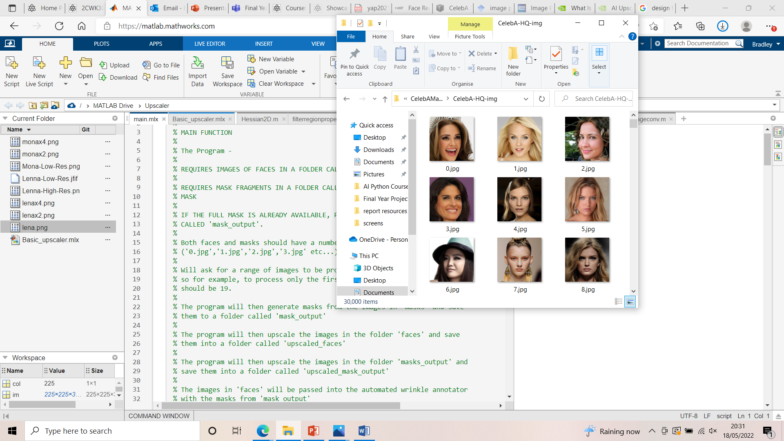
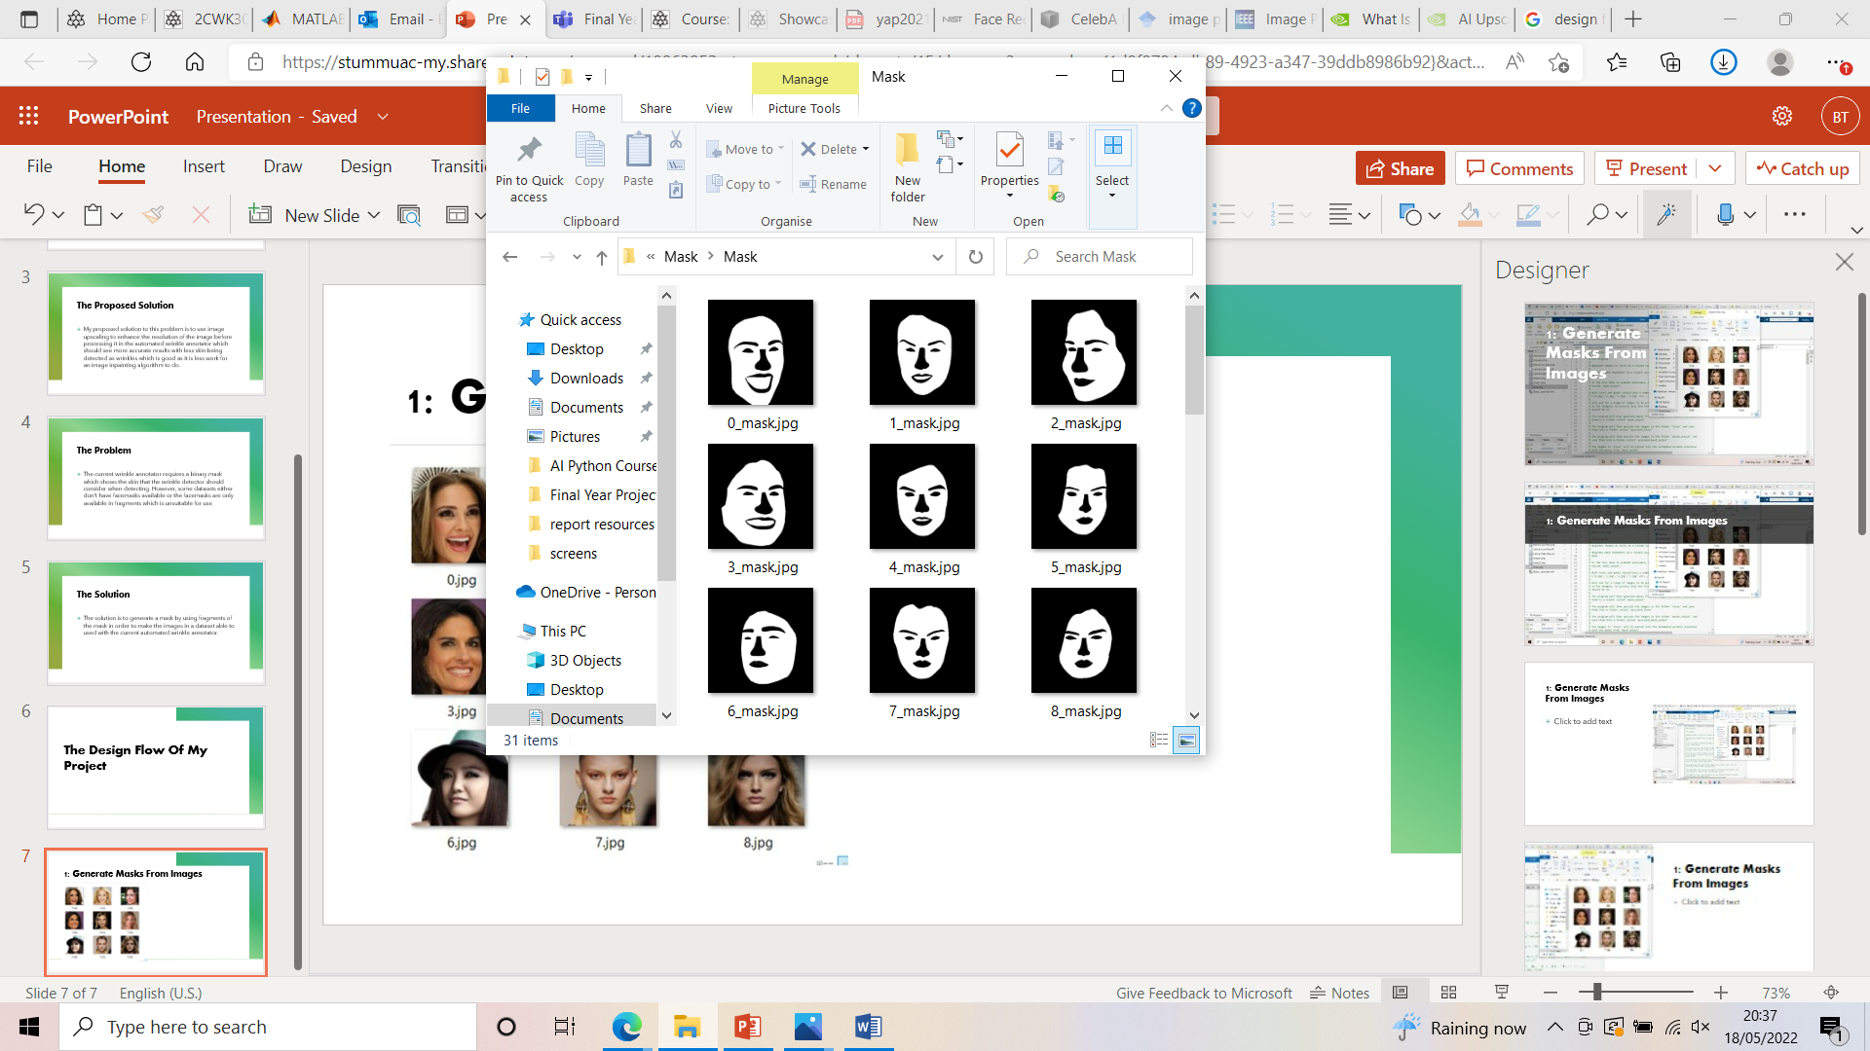
1: Generate Masks From Images

Slide 8

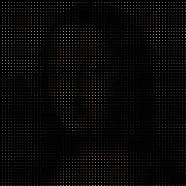
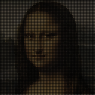
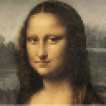
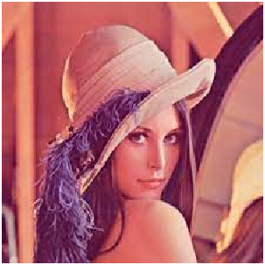



2: Upscale The Images

Slide 9
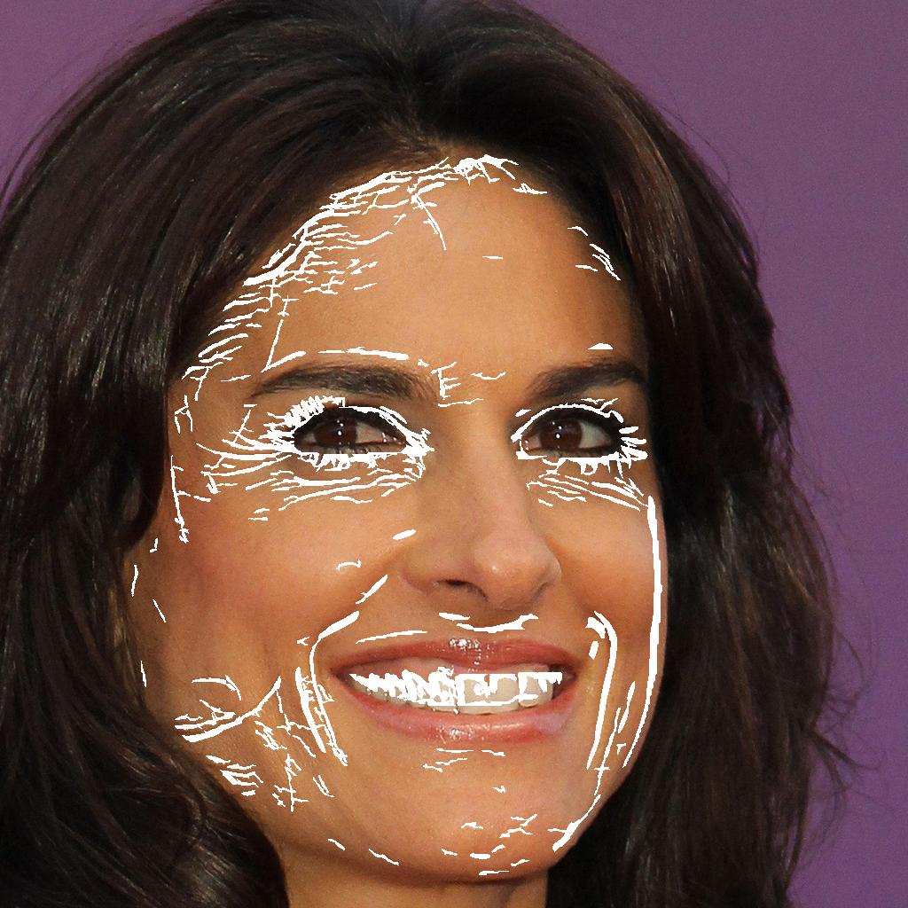
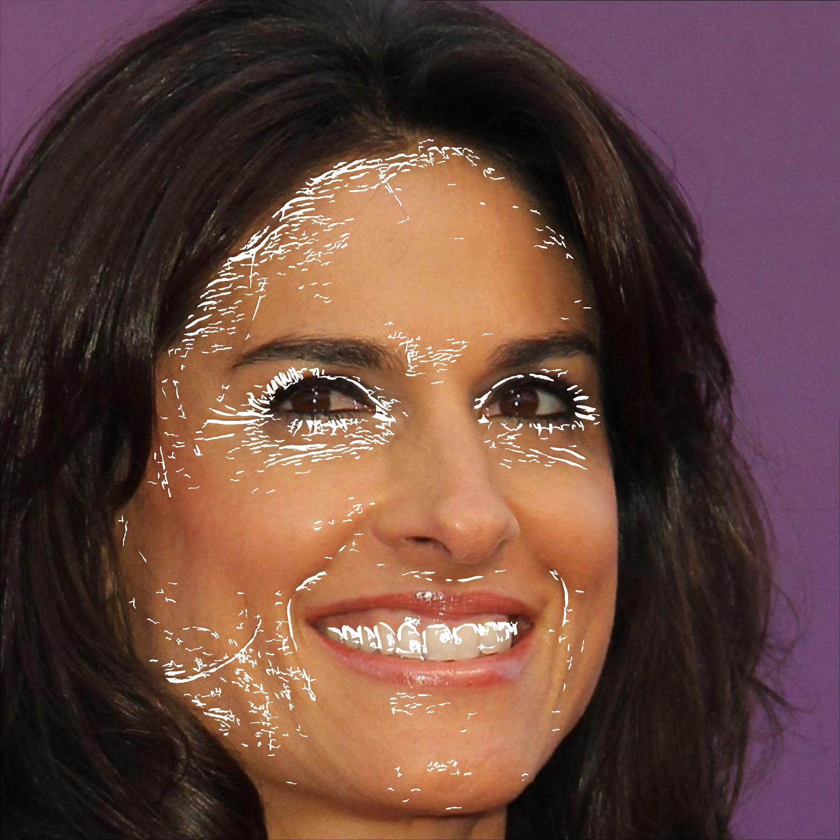
3: Generate Wrinkles For Both Images
No Upscaling
With Upscaling

Slide 10
Evaluations

Slide 11
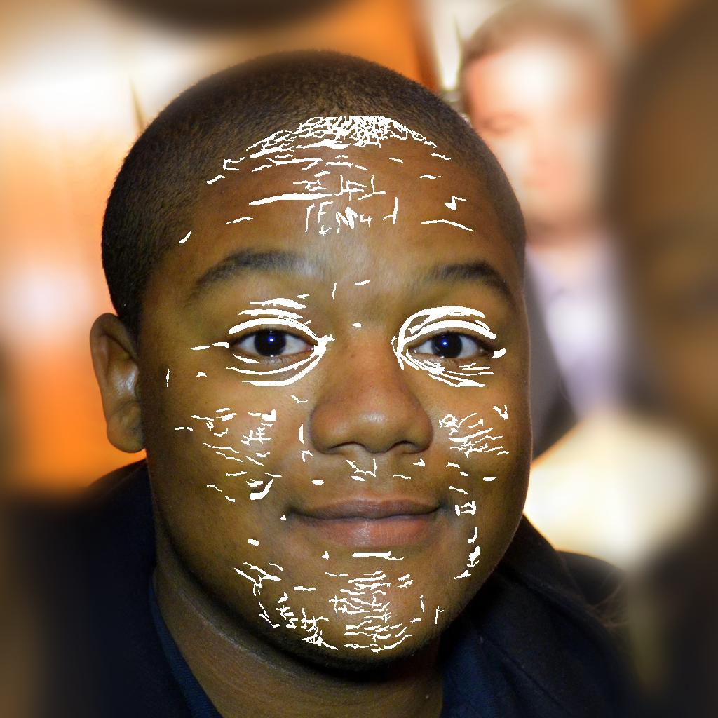
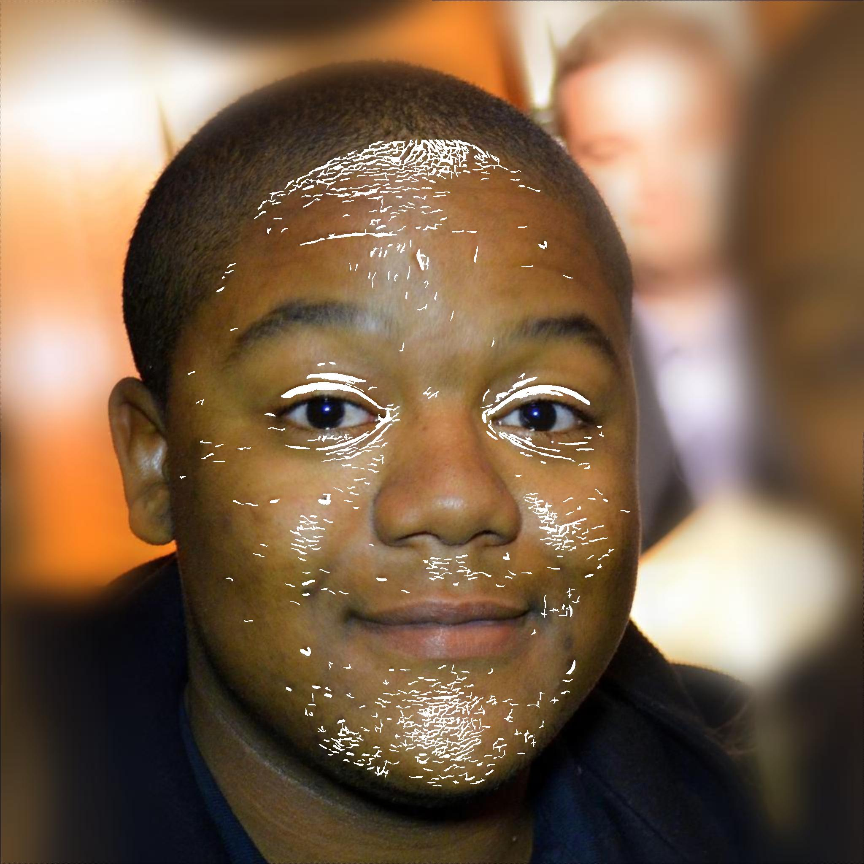

Slide 12
Conclusions
It can be viewed in the comparisons on the previous slide that the upscaled image has a lot of finer, more detailed lines whereas the original image has broader, thicker lines. This is ideal because the less that an inpainting algorithm has to do, the more the image will end up looking like the person and the harder it is to tell that the image has been inpainted.

